Slide 1
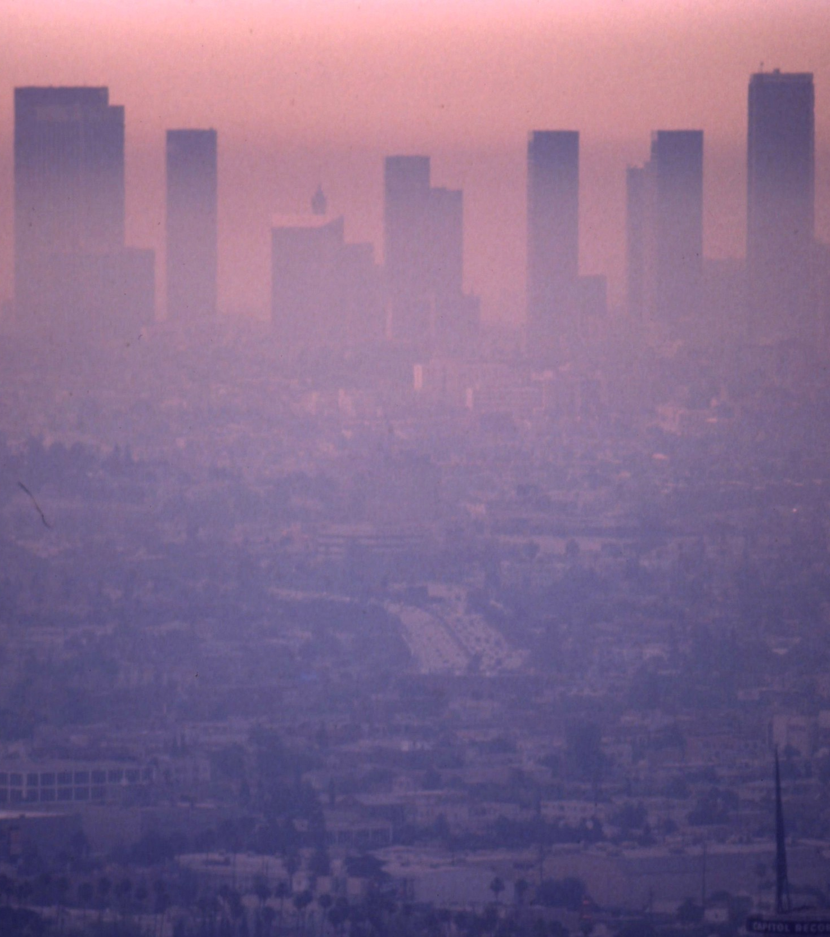
GRAPHITE
Graphing Air Pollution in the Environment

Slide 2

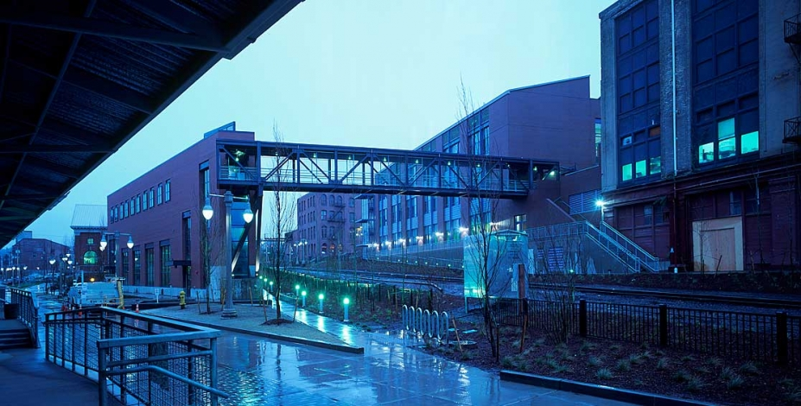
ABOUT US
Team “No Logic”
University of Washington -Tacoma
Agile, impact-driven group
Concerned with the rising level of airborne impurities

Slide 3
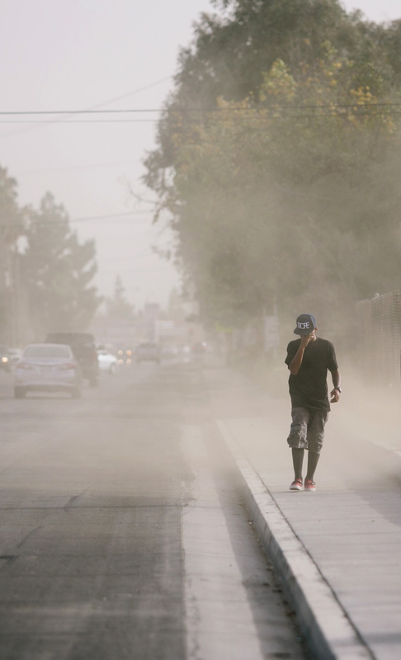
MOTIVATION
It’s people. The more we grow, the more are hurt by progress.
World of exposure with people in need
Los Angeles, California, the 20-year winner *
10k+ illnesses reported since 2017 *
LA exceeds 0.5 ppm Nitrogen Sulfur Dioxide by 18 times on a given day
Exceeds 9 ppm of Carbon Monoxide
*Source: https://archinect.com/news/article/150134484/for-the-19th-time-los-angeles-takes-the-crown-as-the-smoggiest-city-in-the-u-s
Image source: Lexey Swall © hcn.org

Slide 4
MOTIVATION
It’s people. The more we grow, the more are hurt by progress.
World of exposure with people in need
Los Angeles, California, the 20-year winner *
10k+ illnesses reported since 2017 *
LA exceeds 0.5 ppm Nitrogen Sulfur Dioxide by 18 times on a given day
Exceeds 9 ppm of Carbon Monoxide
*Source: https://archinect.com/news/article/150134484/for-the-19th-time-los-angeles-takes-the-crown-as-the-smoggiest-city-in-the-u-s
Image source: Lexey Swall © hcn.org

Slide 5
MOTIVATION
It’s people. The more we grow, the more are hurt by progress.
World of exposure with people in need
Los Angeles, California, the 20-year winner *
10k+ illnesses reported since 2017 *
LA exceeds 0.5 ppm Nitrogen Sulfur Dioxide by 18 times on a given day
Exceeds 9 ppm of Carbon Monoxide
*Source: https://archinect.com/news/article/150134484/for-the-19th-time-los-angeles-takes-the-crown-as-the-smoggiest-city-in-the-u-s
Image source: Lexey Swall © hcn.org

Slide 6

INNOVATION
Visualizer of Los Angeles pollution levels and air quality
Provides various ways of showing the impact of every element from collected sensory data
Demo

Slide 7
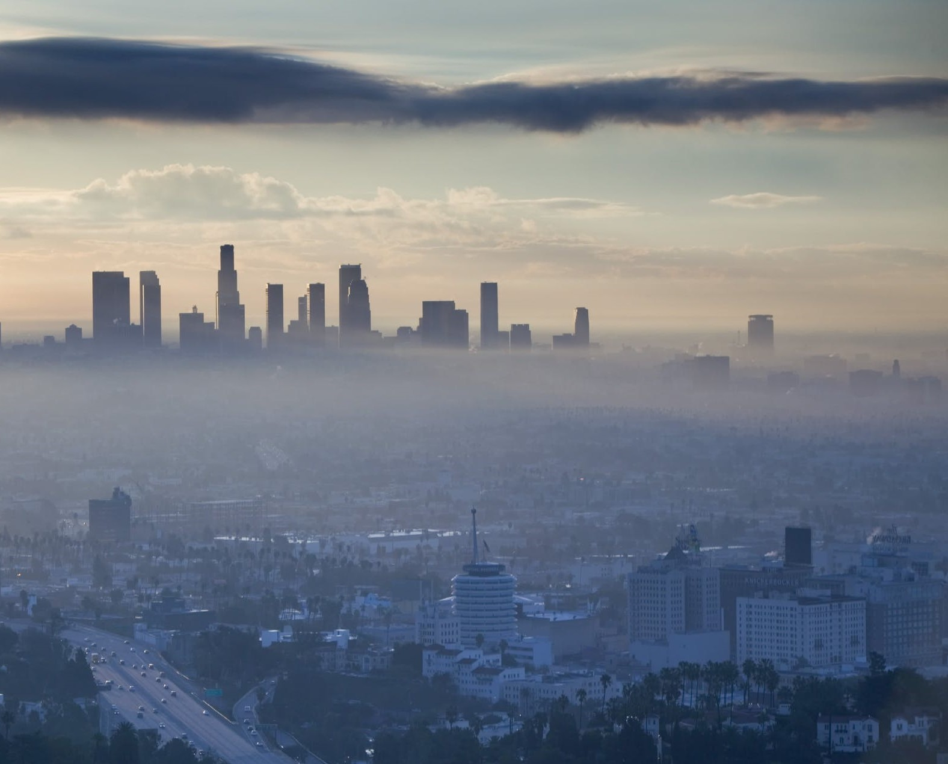
IMPACT
Tackling the problem with higher clarity.
Gain an overall scope of awareness of a rapidly escalating problem for people
Primary needs: more points of data for a larger viewpoint on a global scale
Sensors to determine air pollution saturation (air data was collected from a single location) to predict future growth
Zones of pollution can be predicted
Image source: Los Angeles smog. Image © Walter Bibikow

